Slide 1


Sources: Glowing Bitcoin Symbol Representing the Futuristic Potential and Disruptive Impact | Premium AI-generated image,
https://bicontent.businessinsurance.com/09cd353f-339d-41b3-8dd3-067a730b9d90.jpg

Slide 2


The Dark Side of the Coin: How Cryptocurrency Adoption Relates to Crime
Sofija Kaluderovic

Slide 3

Introduction
Digital, decentralized currency
Simpler, faster and cheaper means of payment for everyday transactions
Not backed by government or central bank
Recorded on a public ledger but users remain pseudonymous
Appeal to legitimate users but also to criminals

Slide 4

Motivation
Increasingly used in fraud, money laundering, ransomware, and illegal marketplaces
Absence of ethical standards and regulatory oversight
Most existing research is either theoretical or focused on specific crimes, with little broad, cross-country empirical analysis

Slide 5

Research Question
How does the level of cryptocurrency adoption influence crime rates in a country?
Research hypothesis: Countries with higher levels of cryptocurrency adoption will experience higher rates of crime.

Slide 6

Literature Review
Kethineni, Sesha, and Ying Cao. "The Rise in Popularity of Cryptocurrency and Associated Criminal Activity." International Criminal Justice Review, vol. 30, no. 3, 2020, pp. 325–344.
Khan, Hira Farman, et al. "Cryptocurrency Crimes: A Systematic Review on Illicit Activities Using Cryptocurrency (Bitcoin) and Challenges for Law Enforcement Agencies." Pakistan Journal of Engineering, Technology & Science, 2024.
Kovalchuk, Olha, et al. "Cryptocurrency Crime Risks Modeling: Environment, E-Commerce, and Cybersecurity Issue." IEEE Access, vol. 12, 2024, pp. 50673–50688.
Dupuis, Daniel, and Kimberly Gleason. "Money Laundering with Cryptocurrency: Open Doors and the Regulatory Dialectic." Journal of Financial Crime, vol. 28, no. 1, 2021, pp. 60–74.

Slide 7


Data Sources
Chainalysis
Leading blockchain data platform
Publishes an annual report that calculates the Global Crypto Adoption Index, scoring countries from 0 to 1.
Global Initiative Against Transnational Organized Crime (GI-TOC)
Calculates the global crime index in collaboration with the European Union, INTERPOL, and Institute for Security Studies (ISS).
Law enforcement
Government transparency and accountability
World Bank Group
GDP per capita (current US$) | Data
Unemployment, total (% of total labor force) (modeled ILO estimate) | Data
A Global Database of Inflation
Individuals using the Internet (% of population) | Data
World Inequality Database
World - WID - World Inequality Database

Slide 8

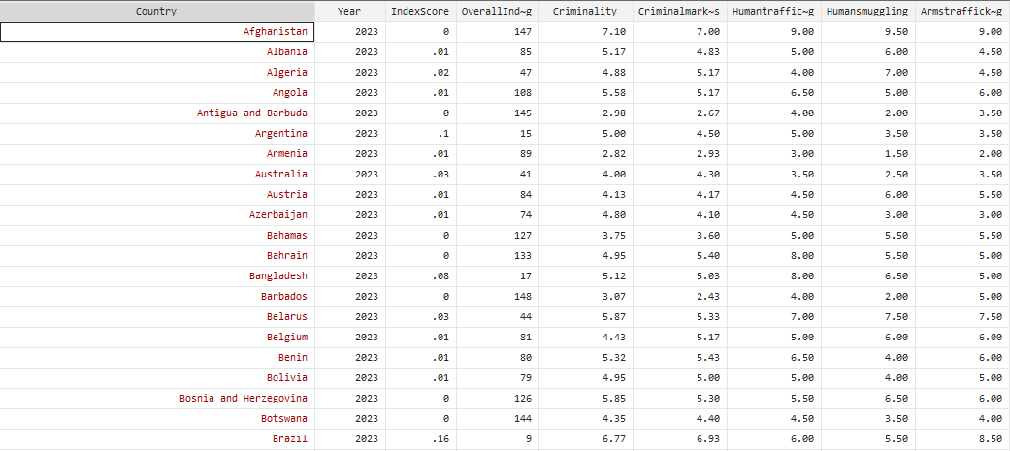
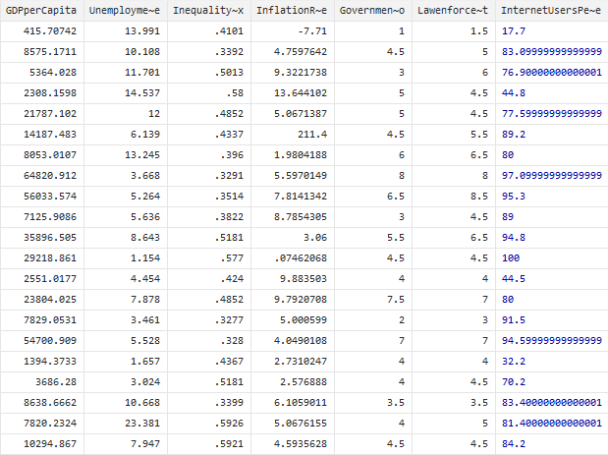
Dataset
Data includes 147 country-level observations from 2023.

Slide 9
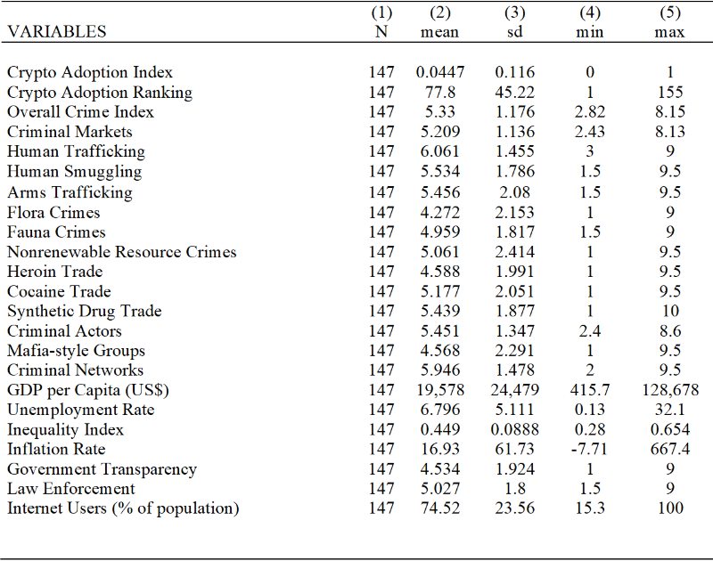

Summary Statistics

Slide 10

Negative Correlation

Slide 11
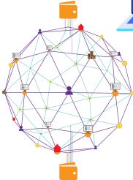
Methodology
Cross-country data from 2023
Ordinary Least Squares (OLS) regressions
A two-way approach (crypto adoption ⇄ crime)
Separate regressions for eight crime categories
A robustness check using data from a different year (2021)

Slide 12
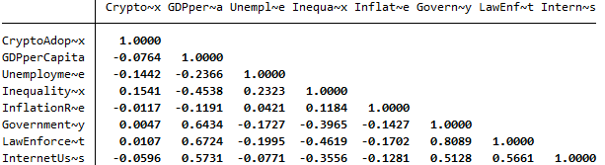

Multicollinearity
Nigeria
Vietnam
Independent Variable Transformation
USA
India
logCryptoAdoptionIndex = log(CryptoAdoptionIndex + 0.01)
Crypto Adoption Index

Slide 13
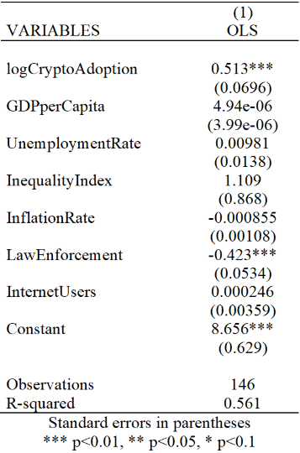
Final Regression Results
Higher crypto adoption is associated with higher crime
→ 1% ↑ in crypto adoption → 0.00513-point ↑ in crime score
Stronger law enforcement linked to lower crime rates
→ 1-point ↑ in law enforcement → 0.423 ↓ in crime score
Doubling crypto adoption leads to a notable rise in crime:
→ A 100% increase in crypto adoption index predicts a 0.513-point rise in crime rate (on a 1–10 scale)

Slide 14
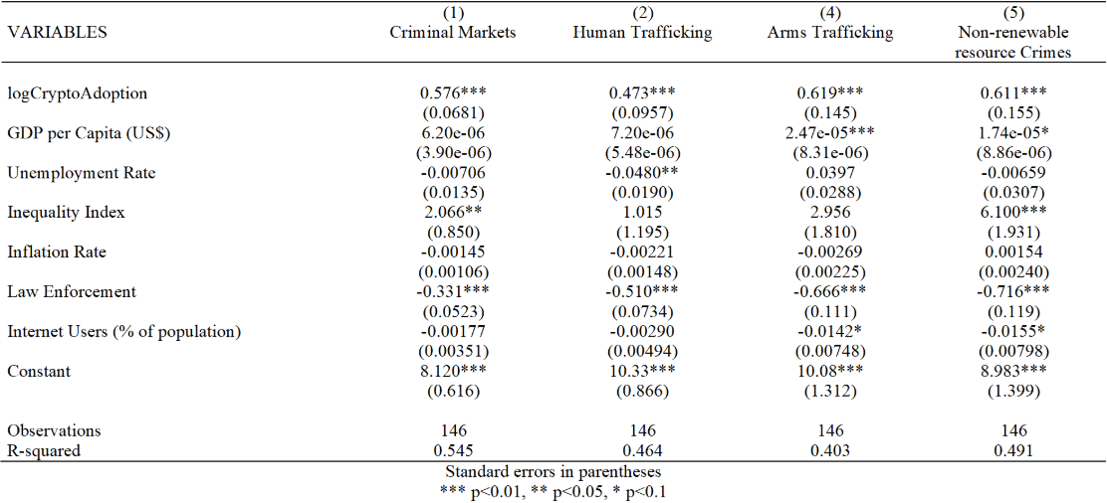
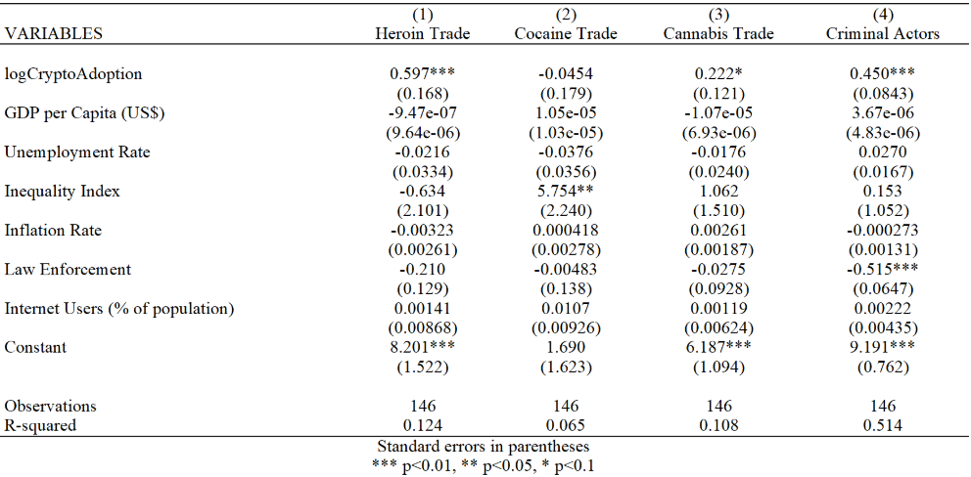
Exploring the Impact Across Crime Categories
Crypto adoption is significant at the 1% level across crime types except for:
Cocaine Trade
(not significant)
Cannabis Trade
(significant at the 10% level)

Slide 15
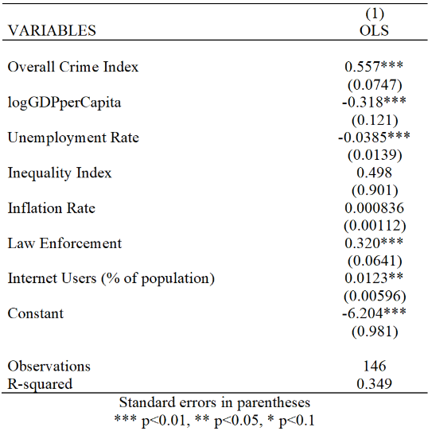
Does Crime Drive Crypto Adoption? Regression Results
Overall Crime Index is significant at the 1% level
A 1-point increase in crime index→ 55.7% rise in crypto adoption
Model suggests some reverse influence, but weaker than crypto → crime

Slide 16
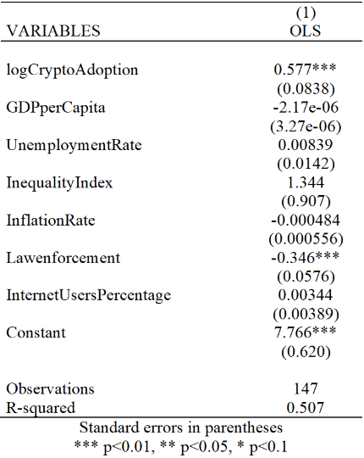
Model Robustness: Results Using 2021 Data
Similar coefficients and significance levels as in 2023 model
Suggests model consistency over time

Slide 17
Limitations
Results show correlation, not causation
Crypto adoption index is normalized
Cross-sectional design limits temporal conclusions
Data may vary in quality and reporting standards
The dataset does not distinguish between legal vs illicit crypto transactions
Unobserved variables (e.g. corruption, digital literacy) may influence both crypto adoption and crime rates

Slide 18

Conclusions
Crypto adoption is positively correlated with crime
Bidirectional relationship
Policy implication: Effective law enforcement may help offset risks associated with crypto use
Crypto adoption shows weaker impact on drug trafficking
Stronger and more consistent effects found for other crime types
Model is applicable across years

Slide 19

Thank You!

